Slide 1






Software Testing
Abdelrahman
Aziz
Shahd
Sara
Nancy

Slide 2



Agenda
KEY TOPICS DISCUSSED IN THIS PRESENTATION
Project Overview Project Purpose Manual Testing Automation Testing
Tools used
Testing Strategy
Test Scenarios
Demo Video

Slide 3

Project Overview

Slide 4
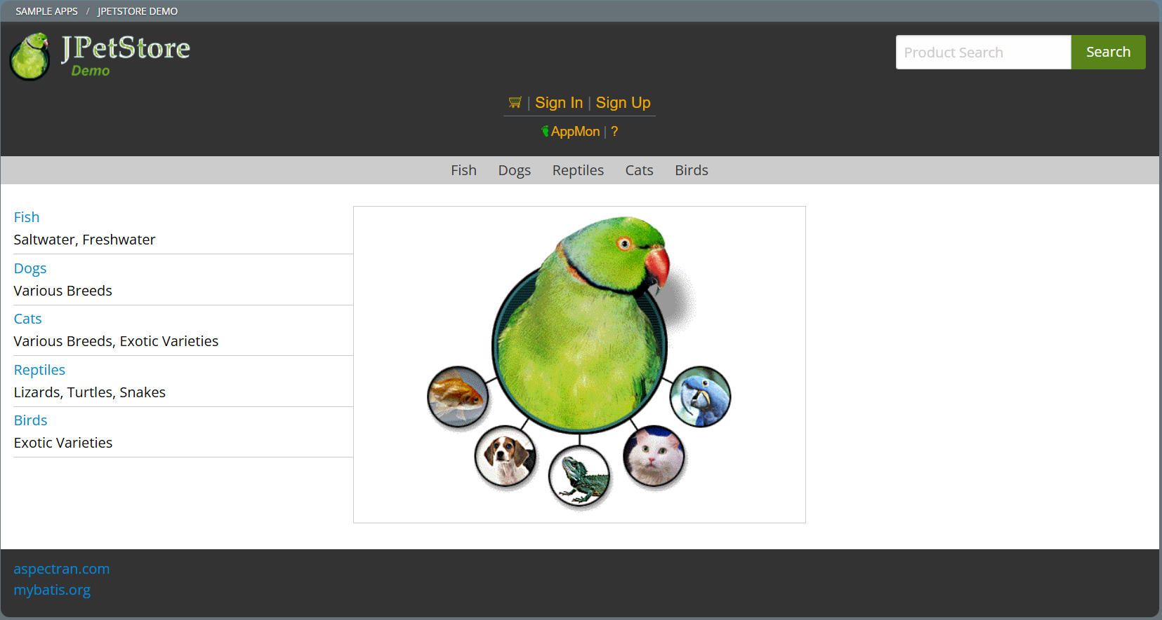
Project Overview
Validate the core functionality of an e-commerce pet store website offering categories for Dogs, Cats, Reptiles, Fish, and Birds through manual and automated testing approaches.
Manual Testing, including test cases covering user interactions such as product search, category navigation, adding/removing items from the cart, updating quantities, and simulating the checkout process.
Selenium-based automated tests verify stability and reliability of critical workflows like search, cart management, and order placement, ensuring consistent behavior across browser sessions.
links:
GitHub link : https://github.com/shhdyasser/SoftwareTesting-FinalProject
Site link : https://jpetstore.aspectran.com/

Slide 5
Project Purpose

Slide 6

Purpose:
Ensure the functionality of the online pet store web application through automated testing.
Validating core features such as:
User login and authentication.
Product search and navigation.
Shopping cart operations (add, remove, update).
Checkout and order processing.
JPetStore

Slide 7
Manual Testing

Slide 8
✅ What is Manual Testing? Manual testing involves executing test cases manually without using automation tools to ensure the application behaves as expected.
🔍 Test Areas Login Functionality User Registration
🧪 Sample Test Case Elements Test Case ID Test Steps Expected Result Actual Result Status (Pass/Fail)

Slide 9
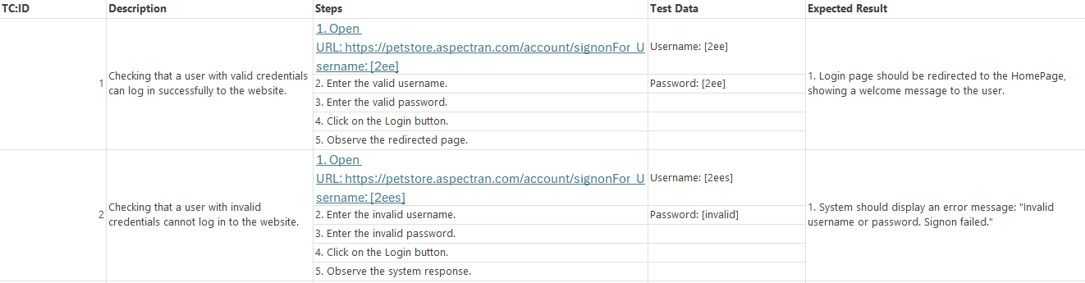
📋 Example Scenarios
✔ Valid login with correct credentials
❌ Login with incorrect username/password
✔ Registration with all required fields
❌ Registration with missing mandatory data

Slide 10
Automation Testing

Slide 11







TOOLS
JAVA
IntelliJ IDEA
Selenium (Automated Testing)
TestNG
Maven
Git & GitHub (Version control)

Slide 12

Why I Used Them
Java | Selenium WebDriver | TestNG
Chosen for its compatibility with Selenium and TestNG, and because it's widely used in automation testing.. | Used to automate browser actions and test web application functionality | Helps in selecting and organizing the tests to run by using tags and configuration files.
 | Git & GitHub
 | Used for version control, managing branches, and handling pull requests
Dependency Management Automatically downloads required libraries (e.g., Selenium, TestNG) via pom.xml. Standard Project Structure Enforces a consistent folder structure for better organization (src/main/java, src/test/java).
Maven

Slide 13
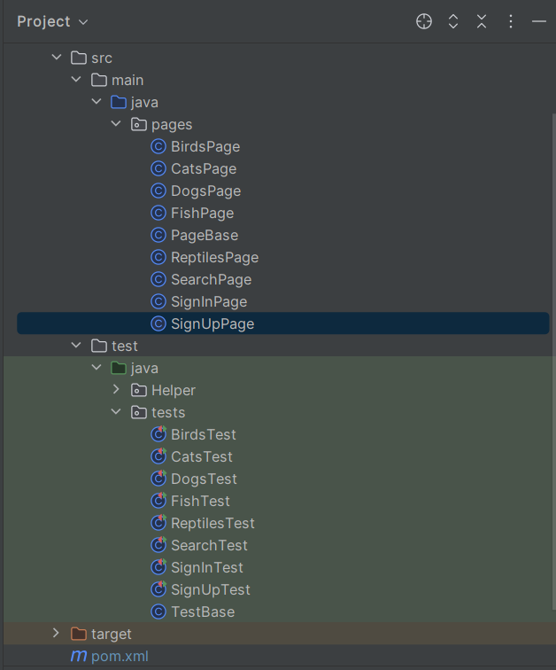
Project Structure (POM Model)
I FOLLOWED THE PAGE OBJECT MODEL (POM) DESIGN PATTERN TO KEEP THE CODE CLEAN, READABLE, AND MAINTAINABLE
IN THIS STRUCTURE:
Pages folder contains classes that represent each page of the website, with locators and actions.
Tests folder contains test scripts that call methods from the page classes.
This separation allows for easier updates and reusability of code

Slide 14


Elment locator
By Xpath:
By Searching for html class by inspect in site and take it in Xpath form to locate elment
By Javascript:
By making first object from class JavascriptExecutor
and go to inspect part and part of JS under HTML to take a reference from

Slide 15

📦 Test Automation Framework Structure
___________________________________
PageBase.java
TestBase.java
LoginHelper.java

Slide 16
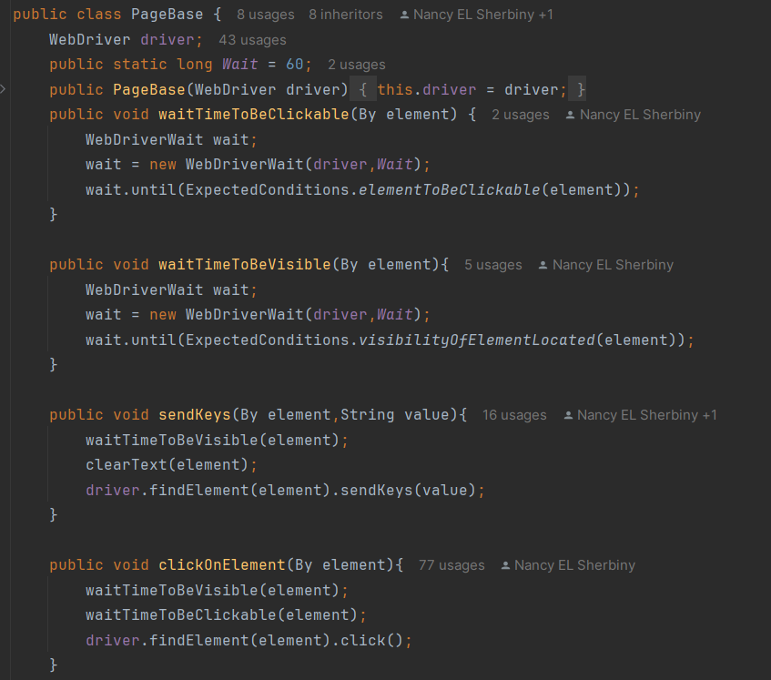
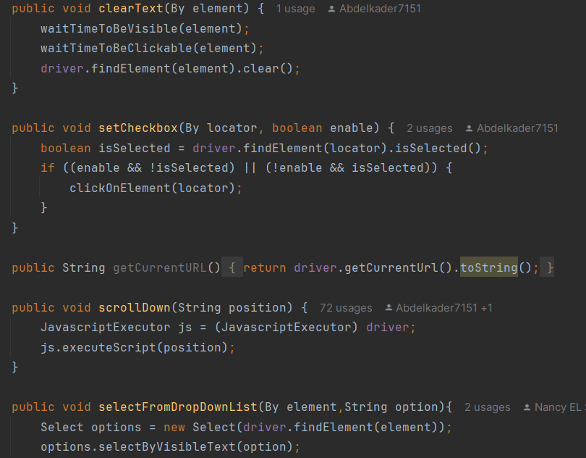
PageBase.java
Main Functions:
Wait Handling: Wait for visibility & clickability using WebDriverWait.
Common Actions: sendKeys(), clickOnElement(), clearText(), scrollDown().
Form Support: Handle dropdowns & conditional checkboxes.
Validation: Verify element visibility & retrieve current page URL.

Slide 17
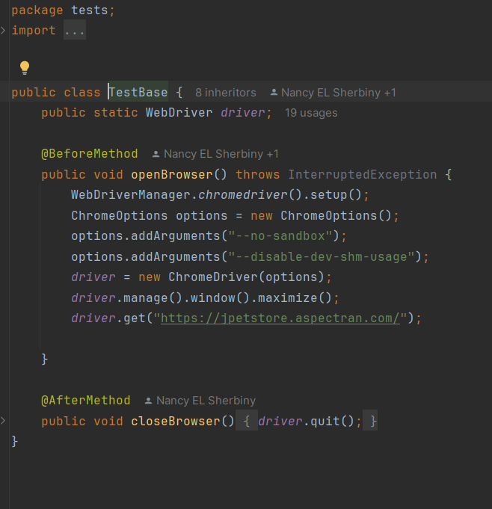
TestBase.java
Main Functions:
Sets up and closes the browser environment before and after each test
@BeforeMethod: Launches Chrome with configurations and navigates to the site.
@AfterMethod: Quits the browser after the test execution

Slide 18
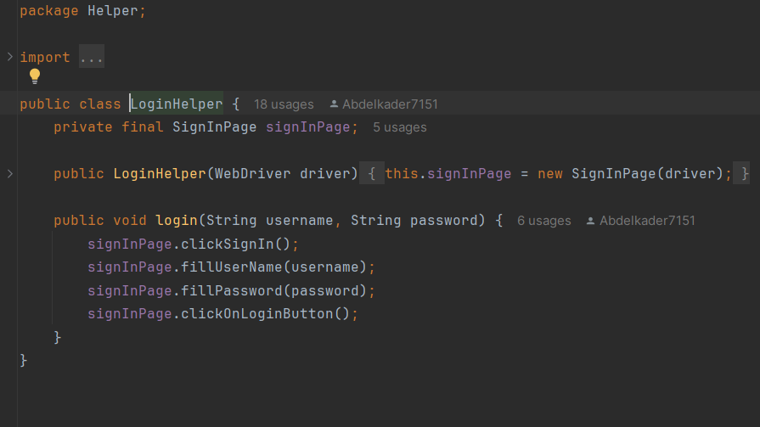
LoginHelper.java
Main Functions:
Simplifies the login process by encapsulating sign-in steps.
Accepts username & password as input
Promotes code reusability across test cases

Slide 19
Test Scenarios
___________________________________
SignInTest.java
SignUpTest.java
CatsTest.java
DogsTest.java
FishTest.java
SearchTest.java

Slide 20
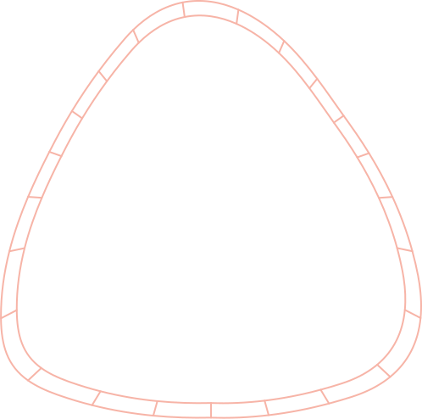
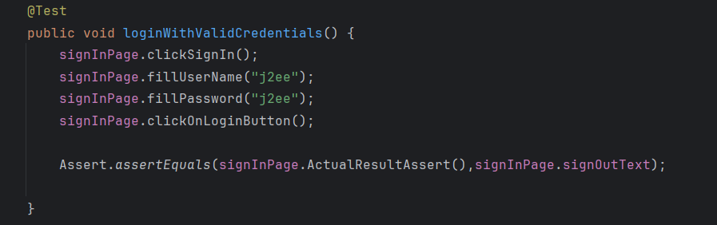
Key Test Scenarios for JPetStore:
clickSignIn() –> Navigates to the login page.
fillUserName("j2ee") –> Inputs the correct username.
fillPassword("j2ee") –> Inputs the correct password.
clickOnLoginButton() –> Submits the login form.
assertEquals(...) –> Verifies the login success by checking if the "Sign Out" text is present.
1)Authentication Testing Scenarios (Login Page)
Valid login with correct credentials.

Slide 21
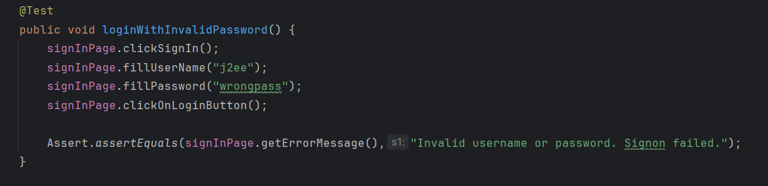
Key Test Scenarios for JPetStore:
1)Authentication Testing Scenarios (Login Page)
clickSignIn() → Navigates to the login page.
fillUserName("j2ee") → Inputs a valid username.
fillPassword("wrongpass") → Inputs an incorrect password.
clickOnLoginButton() → Submits the login form.
Assert.assertEquals(...) → Verifies that the error message is shown: "Invalid username or password. Signon failed."
2.Login attempt with invalid credentials.

Slide 22
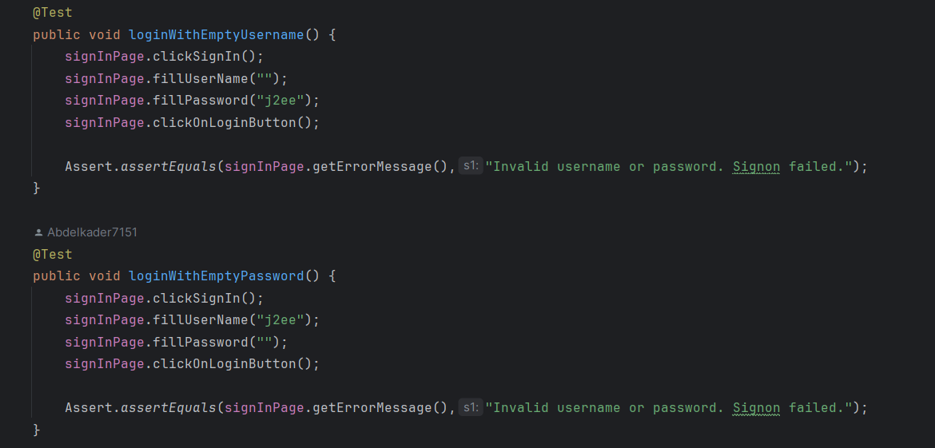
Key Test Scenarios for JPetStore:
clickSignIn() → Navigates to the login page.
fillUserName("nonexistent_user") →
Inputs a username that does not exist in the system.
fillPassword("anypass") → Inputs any password.
clickOnLoginButton() → Submits the login form.
Assert.assertEquals(...) → Verifies that the same error message appears: "Invalid username or password. Signon failed."
1)Authentication Testing Scenarios (Login Page)
3.Submitting empty username or password fields.

Slide 23
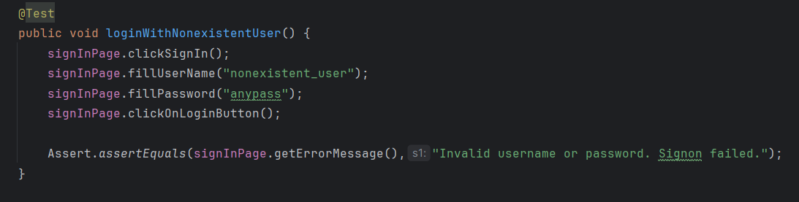
Key Test Scenarios for JPetStore:
1)Authentication Testing Scenarios (Login Page)
Both tests start by navigating to the login page and submitting the form.
loginWithEmptyUsername(): Leaves the username field empty, fills in password "j2ee".
loginWithEmptyPassword(): Inputs username "j2ee", leaves the password field empty.
Both verify the same error message: "Invalid username or password. Signon failed."
4.Login with non existing user.

Slide 24
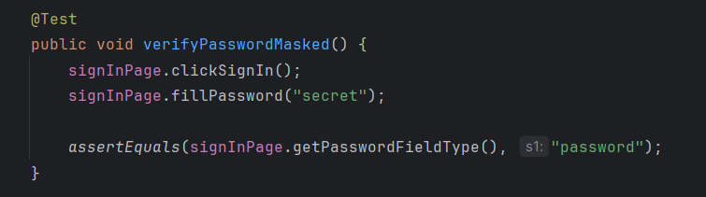
Key Test Scenarios for JPetStore:
1)Authentication Testing Scenarios (Login Page)
5.Password field masking is enabled.
clickSignIn() → Navigates to the login page.
fillPassword("secret") → Inputs a password.
assertEquals(signInPage.getPasswordFieldType(), "password") → Verifies that the password input field type is "password", meaning the characters are masked (not visible).

Slide 25
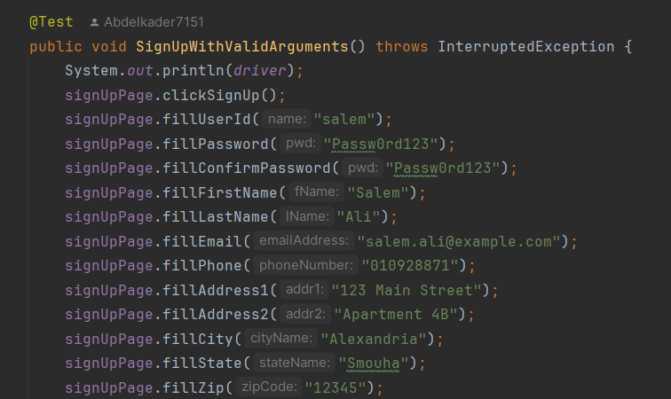
Key Test Scenarios for JPetStore:
2) Signup Testing Scenarios (Register Page)
clickSignup() –> Navigate to Signup Page
Fill all required fields
Username: salem
Password / Confirm Password: Passw0rd123
First & Last Name
Email: salem.ali@example.com
Phone, Address, City, State, Zip
Country: Egypt
Language Preference: Korean
Favorite Category: Cats
SignUp With Valid Arguments

Slide 26
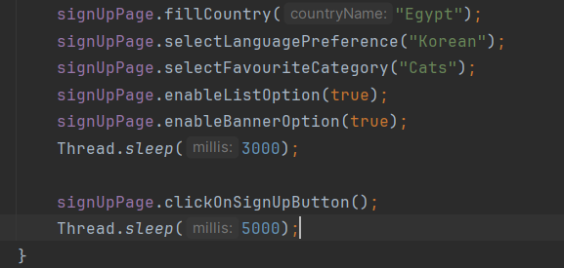
Key Test Scenarios for JPetStore:
2) Signup Testing Scenarios (Register Page)
Sign Up With Valid Arguments
enableListOption(true); –> Enable additional options List
enableBannerOption(true); –> Enable additional options Banner
clickOnSignUpButton();–> Click the "Sign Up" button

Slide 27
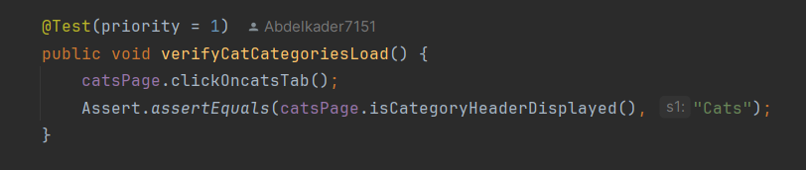
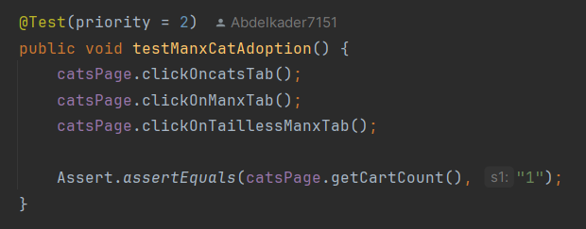
Key Test Scenarios for JPetStore:
click0ncatsTab() –> Click on the "Cats" tab.
assertEquals(...) –> Verifies that the category header is correctly shown
clickOnManxTab() –> Select the "Manx" category.
clickOnTaillessManxTab() –> Click on the tailless Manx option..
assertEquals(...) –> Verifies that one item has been added to the cart..
3) Test Scenarios – Cats Section
verify Cat Categories Load
2. test Manx Cat Adoption

Slide 28
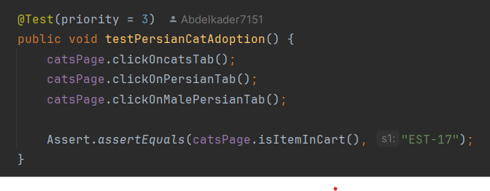
Key Test Scenarios for JPetStore:
click0ncatsTab() –> Click on the "Cats" tab.
clickOnPersianTab() –> Select the "Persian" category..
clickOnMalePersianTab() –> Click on the male Persian option..
assertEquals(...) –> Verifies that the correct item ("EST-17") is in the cart.
3) Test Scenarios – Cats Section
3.test Persian Cat Adoption

Slide 29
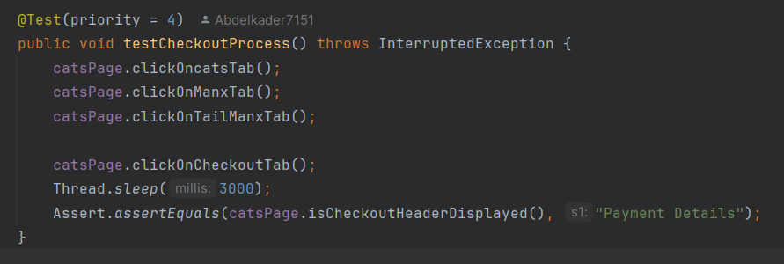
Key Test Scenarios for JPetStore:
click0ncatsTab() –> Click on the "Cats" tab.
clickOnManxTab() –> Select the "Manx" category.
clickOnTaillessManxTab() –> Click on the tailless Manx option
clickOnCheckoutTab()
–> Click on the "Checkout"
button..
assertEquals(...) –> Confirms that the checkout page is successfully displayed.
3) Test Scenarios – Cats Section
4.test Checkout Process

Slide 30
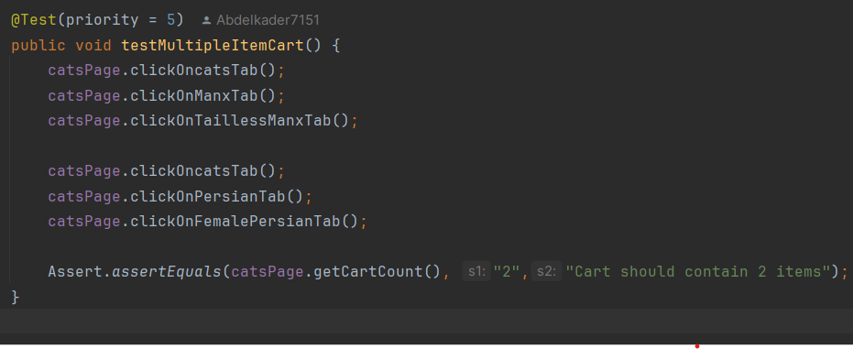
Key Test Scenarios for JPetStore:
3) Test Scenarios – Cats Section
Add a tailless Manx cat to the cart.
Add a female Persian cat to the cart.
assertEquals(...) –> Verifies that the cart contains two items after adding both cats.
5.test Multiple Item Cart

Slide 31
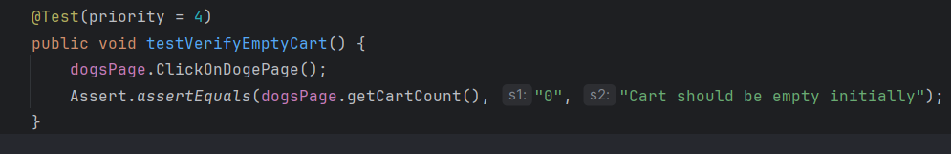
Key Test Scenarios for JPetStore:
4) Test Scenarios – Dogs Section
ClickOnDogePage() → Navigates to the Dogs page.
getCartCount() → Retrieves the number of items currently in the cart.
Assert.assertEquals(...) → Verifies that the cart count is "0", ensuring the cart is empty initially.
Test Verify Empty Cart.

Slide 32
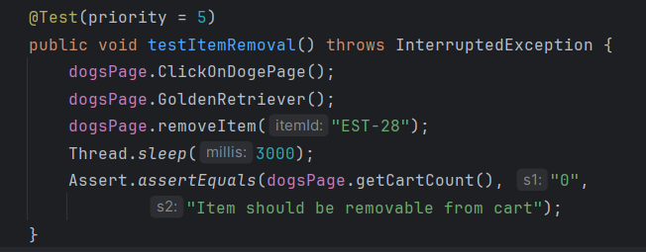
Key Test Scenarios for JPetStore:
ClickOnDogePage() → Navigates to the Dogs page.
GoldenRetriever() → Selects the Golden Retriever item.
removeItem("EST-28") → Removes the item with ID EST-28 from the cart.
Thread.sleep(3000) → Waits for 3 seconds to ensure the removal is processed.
Assert.assertEquals(...) → Verifies that the cart count is "0", confirming the item was removed successfully.
4) Test Scenarios – Dogs Section
2. Test Item Removal.

Slide 33
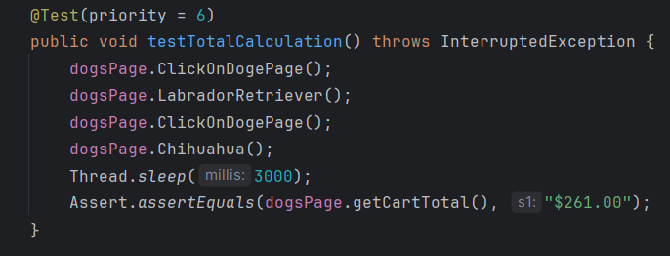
Key Test Scenarios for JPetStore:
ClickOnDogePage() → Navigates to the Dogs page.
LabradorRetriever() → Adds the Labrador Retriever to the cart.
ClickOnDogePage() → Navigates back to the Dogs page again.
Chihuahua() → Adds the Chihuahua to the cart.
Thread.sleep(3000) → Waits for 3 seconds to ensure both items are added.
Assert.assertEquals(...) → Verifies the cart total is "$261.00", confirming correct price calculation.
4) Test Scenarios – Dogs Section
3. Test Total Calculations.

Slide 34
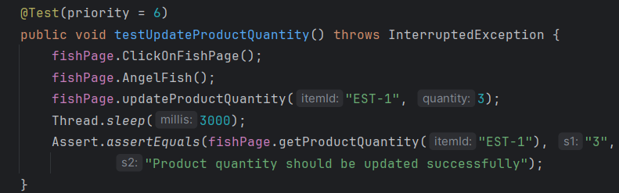
Key Test Scenarios for JPetStore:
5) Test Scenarios – Fish Section
ClickOnFishPage() → Navigates to the Fish page.
AngelFish() → Selects the Angel Fish product.
updateProductQuantity("EST-1", 3) → Updates the quantity of product EST-1 to 3.
Thread.sleep(3000) → Waits for 3 seconds to allow the update to process.
Assert.assertEquals(...) → Verifies that the product quantity is "3", confirming the update was successful.
1. Test Update Product Quantity.

Slide 35
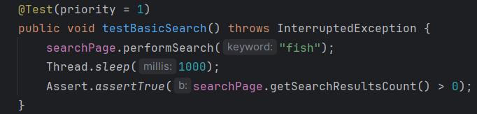
Key Test Scenarios for JPetStore:
6) Test Scenarios – Search Section
1. Test Basic Search.
performSearch("fish") → Executes a search for the keyword "fish".
Thread.sleep(1000) → Waits for 1 second to allow results to load.
Assert.assertTrue(...) → Verifies that the number of search results is greater than 0, confirming the search works correctly.

Slide 36
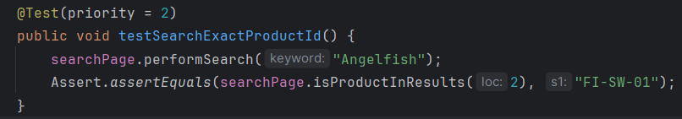
Key Test Scenarios for JPetStore:
6) Test Scenarios – Search Section
2. Test Search Exact Product ID.
performSearch("Angelfish") → Performs a search for the product "Angelfish".
isProductInResults(2) → Checks the product ID at result index 2.
Assert.assertEquals(...) → Verifies that the product ID is "FI-SW-01", confirming accurate search results.

Slide 37
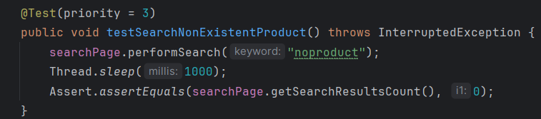
Key Test Scenarios for JPetStore:
6) Test Scenarios – Search Section
3. Test Search Non Existent Product.
performSearch("noproduct") → Executes a search for a non-existent product.
Thread.sleep(1000) → Waits 1 second for any results to load.
Assert.assertEquals(...) → Verifies the result count is 0, confirming that no products are returned for invalid input.

Slide 38
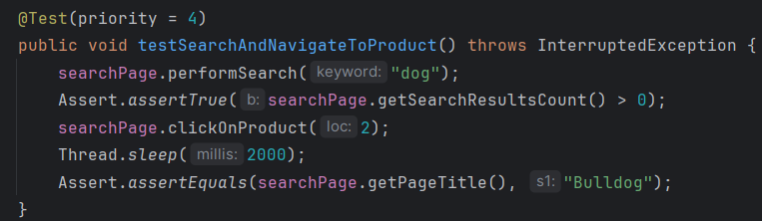
Key Test Scenarios for JPetStore:
6) Test Scenarios – Search Section
performSearch("dog") → Searches for products related to "dog".
Assert.assertTrue(...) → Verifies that the search returns at least one result.
clickOnProduct(2) → Clicks on the product at index 2 in the search results.
Thread.sleep(2000) → Waits 2 seconds for the product page to load.
Assert.assertEquals(...) → Verifies that the page title is "Bulldog", confirming correct navigation.
4. Test Search And Navigation Product.

Slide 39
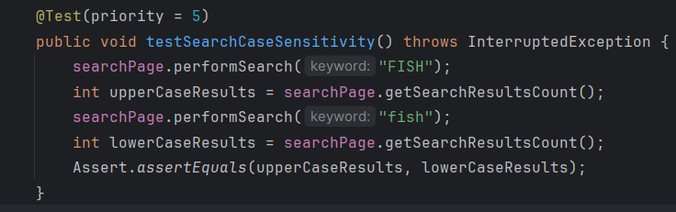
Key Test Scenarios for JPetStore:
performSearch("FISH") → Performs a search using uppercase input.
getSearchResultsCount() → Stores the number of results found for "FISH".
performSearch("fish") → Performs the same search using lowercase input.
getSearchResultsCount() → Stores the number of results found for "fish".
Assert.assertEquals(...) → Verifies that both search results are equal, confirming the search is case-insensitive.
6) Test Scenarios – Search Section
5. Test Case Sensitivity.

Slide 40
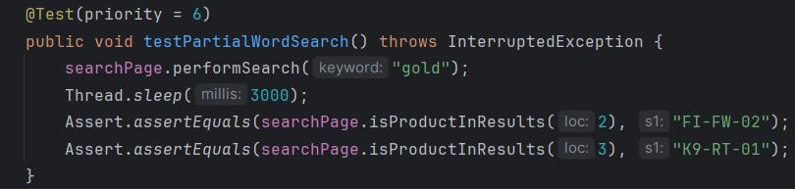
Key Test Scenarios for JPetStore:
6) Test Scenarios – Search Section
performSearch("gold") → Performs a search using the partial word "gold".
Thread.sleep(3000) → Waits 3 seconds for results to load.
isProductInResults(2) → Verifies that the product at index 2 has ID "FI-FW-02".
isProductInResults(3) → Verifies that the product at index 3 has ID "K9-RT-01", confirming partial word search is effective.
6. Test Partial Word Search.

Slide 41
DEMO VIDEO

Slide 42
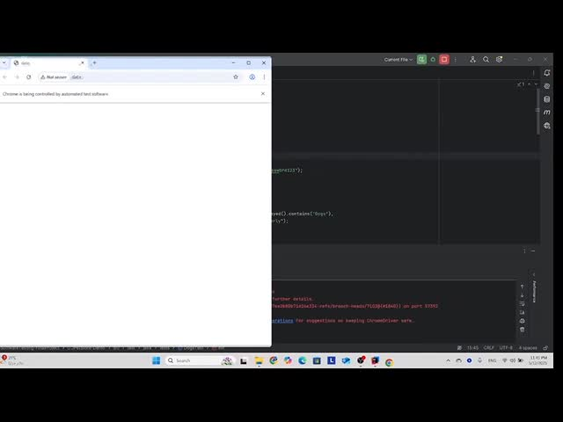

Slide 43

Conclusion:
The online pet store project highlights the value of both manual and automated testing in ensuring a reliable and user-friendly web application.
Focused on critical functionalities such as:
Browsing pets by category (Dogs, Cats, Reptiles, Fish, Birds)
Shopping cart management
Order completion and checkout
Verified that the system behaves correctly under various scenarios.
Automated testing enabled efficient, repeatable validations across workflows.
This led to:
Better performance
Higher software quality
Improved user satisfaction
The testing approach provides a solid foundation for future maintenance and scalability of the platform.

